Slide 1

Highfield Community Primary School
Writing Curriculum Guidance

Slide 2

Our Approach to Teaching Writing at
Highfield Community Primary School
Publish to intended audience
Proof read, edit content and improve
Write independently
Apply in ‘short burst’ writing
Plan writing
Teach, practise and develop writing tools and techniques
Deepen and broaden vocabulary knowledge
Immerse children in the content (give them knowledge of what they are writing about)
Establish purpose and audience for the writing
Hook and engage interest
We expect our teachers to see writing as a process that requires responsive teaching and the ability to move back and forwards between different aspects of writing instruction rather than viewing this as a linear process. This is why our approach is represented using a spiral: teaching will move between the different aspects e.g. develop some vocabulary, teach and practise a new grammar skill incorporating the taught vocabulary, then return to explicitly teach more vocabulary to broaden the range of available words OR practise a particular technique, apply it into a short writing task and then, as appropriate, revisit the technique to repair misunderstanding or develop and deepen understanding. Effective delivery of the curriculum requires teachers to feedback to children at all stages and use assessment to inform next steps in teaching.
This document explains the rationale and approaches used in our writing curriculum in more detail as well as providing some examples of what the writing process looks like throughout the school.

Slide 3
Writing Lessons
Rationale for the texts chosen:
Texts become increasingly challenging as children move through the year and across the Year groups (R-Y6). Challenge has been judged using lexiles (where appropriate), vocabulary and sentence structure and complexity of the theme.
There is an expectation that the books will be supplemented with further model texts as part of our approach to teaching writing. This ensures appropriate challenge and enough exposure to the range and quality of vocabulary and sentence structure required for each year group.
The range of texts has been deliberately and carefully planned to ensure that the children have a rich, diverse and balanced reading ‘diet’ as they move through school. (PLEASE NOTE: if a teacher wants to change a text e.g. a new text is discovered, there has been a text based training session etc, this must be done in consultation with the subject leader to ensure that any change does not disrupt/change the balance of texts)
In the narrative selection, we have chosen books to ensure balance of genres, key characters that represent the diversity in our society progression in traditional tales, a range of contemporary texts and an introduction to classic texts.
In the non-fiction selection, we have planned books that use a range of themes and topics (e.g. animals, inventions, mysteries, machines, nature, space etc.)
In the poetry selection, we have ensured that there is diverse representation in the poets that children study and that there is progression in the poetry forms studied and written as well as the opportunity to study poems closely before practising and performing aloud to an audience.
All of the above, has also been balanced against texts chosen for guided/whole class reading sessions and our ‘read aloud for pleasure’ offering.
Each unit of work lasts between 3-5 weeks and is delivered through a daily, 1 hour English lesson.
Each unit will incorporate:
1. A hook
2. Immersion in the text
3. Writing tools and techniques
4. Planning
5. Proof reading and editing
6. Publishing
In our school, we follow a ‘book based’ approach using high-quality books as the core text to stimulate ideas and topics for writing. The aim is for pupils to explore the texts in a sustained way and engage with the materials in depth; thereby, providing content for their own writing.

Slide 4
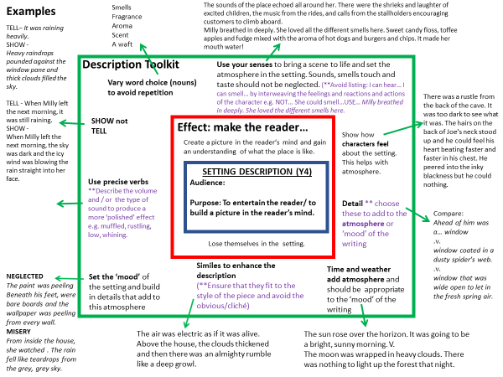
Teachers will produce ‘Writing toolkits’ for each unit which will serve as medium term plans. This will identify the purpose and audience of the writing. It will also identify the vocabulary and grammar that will be taught during the unit.
This resource was been designed to support teachers to plan a writing unit of work. The layout was originally promoted by James Durran @jdurran (https://jamesdurran.blog/2019/01/24/re-thinking-success-criteria-a-simple-device-to-support-pupils-writing/)
Teachers begin at the centre of the toolkit and work outwards.
Box 1- text, audience & purpose. It is vital that teachers begin by deciding why the children are writing and who they are writing for. This is essential information to share with children from the outset and throughout the unit. By referring to ‘the reader’ teachers can show children how to make choices to engage and inform effectively
Box 2- effect: make the reader. This is where children are guided to think about how the reader should feel. This will determine the features in box 3. Precise choices will be made when children are taught to think carefully about the effect of the choices they make.
Box 3- toolkit. Consider the writing features needed for a specific genre . These will include specific writing/genre features and literary techniques. Our medium-term plans show the techniques and grammar features that the children will focus on (in depth) during the unit
Box 4- examples. This part of the process is essential and should not be missed. Teachers need to take the time to think about specific examples and sentences relevant to the audience and purpose. Consider voice, style and register. Completing this box will help teachers to clarify what should be included to write effectively, what to avoid and how to build this into their modelled writing
The toolkit is displayed on the class working wall and will be constructed with the class and developed/added to as new techniques are taught and explored. The toolkit is a dynamic, evolving resource that is added to and adjusted as ideas are developed and shared through the immersion, skill and vocabulary development and planning stages of writing.
At every stage, the teacher should refer to the centre of the toolkit (audience, purpose and effect) for feedback and to guide peer and self-assessment – is the writing achieving what it is meant to achieve? What is the effect of that on your reader?

Slide 5

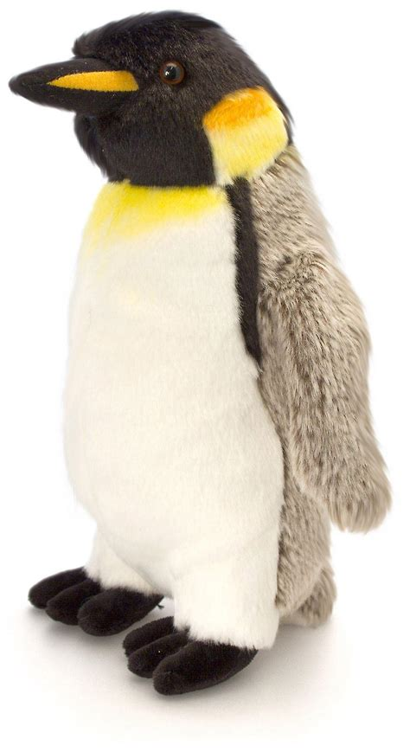

1. Hook:
The aim of ‘the hook’ is to engage the pupils’ interest, to inspire and to captivate attention. The hook ignites interest and, depending on the hook used, it can
introduce children to characters, setting and plotlines
stimulate discussion on key themes
offer first-hand experience and greater understanding of events/the context of the text
establish purpose and audience for the writing
ENGAGE WITH THE STORY, IDEA, THEME
Something appears/arrives in the classroom/school:
An item appears in class e.g. a beanstalk, footprint, character item, egg, figure etc. It may be accompanied by a label/letter e.g. ’Lost and Found’ by Oliver Jeffers – a penguin toy appears in class with a LOST label around its neck. This stimulates discussion on what the children can do to help - how can we find the owner? Where do penguins come from? How can we get it back? How do we look after it in the meantime?
A staged setting e.g. An alien crash site, police taped crime scene etc
A daily build up of clues before the new unit begins: an arrow embedded in the wall, a feather (from a hat), some leaves, a torn wanted poster (Robin Hood)
LOST
Receive a package:
E.g. ‘Dear Zoo’ - the class receive packages (animal figures or toys wrapped up) and each one is labelled with a clue such as ‘very heavy’, ‘too tall’ etc. Adapt the clues depending on age of the children e.g. the type of wrapping used, the wording of the clue etc.
Use an artefact as an initial stimulus e.g. an important object from the story
Receive a Letter:
A letter arrives in class from a book character with a problem/asking for help OR this can be used to stimulate non-fiction writing such as a scientist or explorer, who needs some help with background research, the Headteacher asking children to report back on something or from an official or organisation asking for opinion or research.
Drama:
Gingerbread Man - Teacher is in class in a cooking apron and oven gloves and tells the children that s/he has made some gingerbread men as a surprise for them. The class go to the oven/kitchen and find that the gingerbread men are gone leaving only a trail of crumbs…
Teacher in role/costume (this can be anything from a full costume to just a prop e.g. a scarf, hat or key piece of clothing to represent the character). Act out a scene or talk to the children to present a problem.

Slide 6
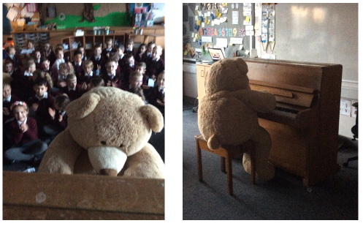

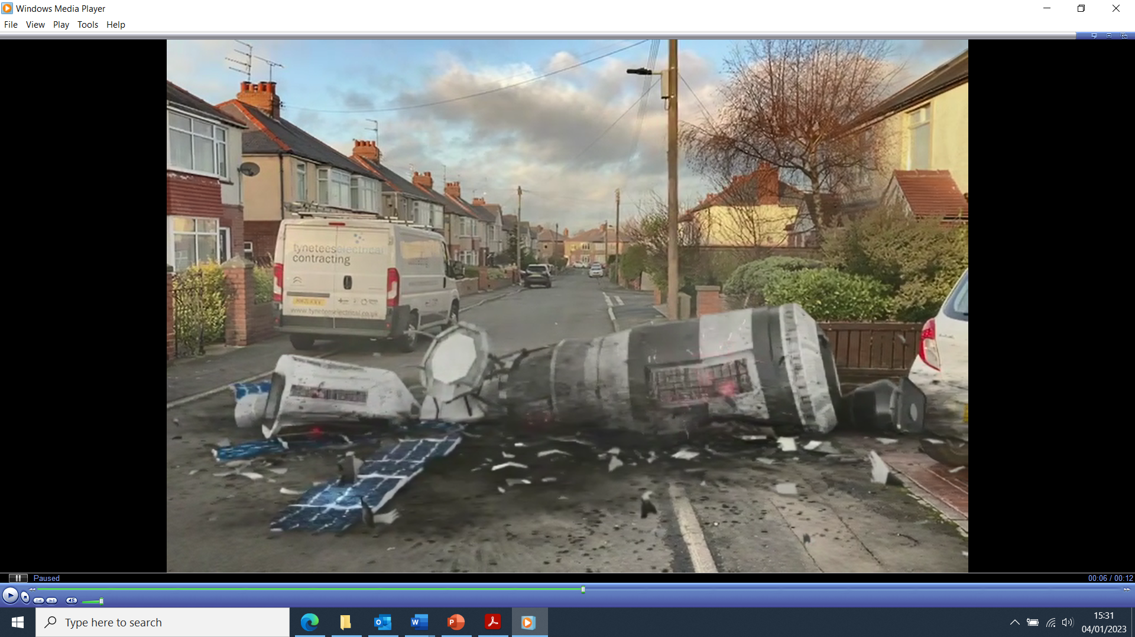
Experience:
Children take part in an experience linked to the text e.g. if they are watching the Literacy Shed film ‘Marshmallows’, can they first experience the campfire and toasting marshmallows? If they are reading ‘Leon and the Place Between’, can you organise a circus visit, invite a circus group into school to teach circus tricks or perform for the children? Or can you issue tickets, give out popcorn and show a film of a circus in action? If they are reading ‘The Bear and the Piano’, can they receive an invite and attend a piano performance by the bear? All these experiences offer the children some first hand experience and, therefore, some understanding and context for the story.
Augmented Reality:
Use an online site (such as FX GURU) to create a video e.g. explosion in the school grounds, zoo animals escape through your local area, tree giant appears in school, gingerbread man escaping etc. Show the children the video to launch narrative or report writing.
CCTV ‘footage’ of an event in school e.g. ‘Scarecrow’s Wedding’ by Julia Donaldson – the Scarecrow is seen on CCTV footage moving across the yard and leaving the premises.
Introduce a quote, line from the book or key word:
Choose a key word to explore e.g. ‘pioneer’ – what is the children’s understanding of the word (it may need to be explicitly taught), examples of people who are pioneers. This then leads into the text about someone who is considered a ‘pioneer’
Opening sentence: Henry Brown wasn’t sure how old he was. (Taken from ‘Henry’s Freedom Box’ by Ellen Levine)
Reveal the opening text sentence by sentence and visualise/explore in depth with the children. Reveal one sentence at a time, discuss and build the picture/understanding as each new bit of text is revealed.

Slide 7
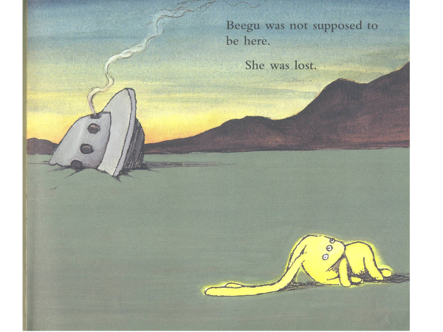
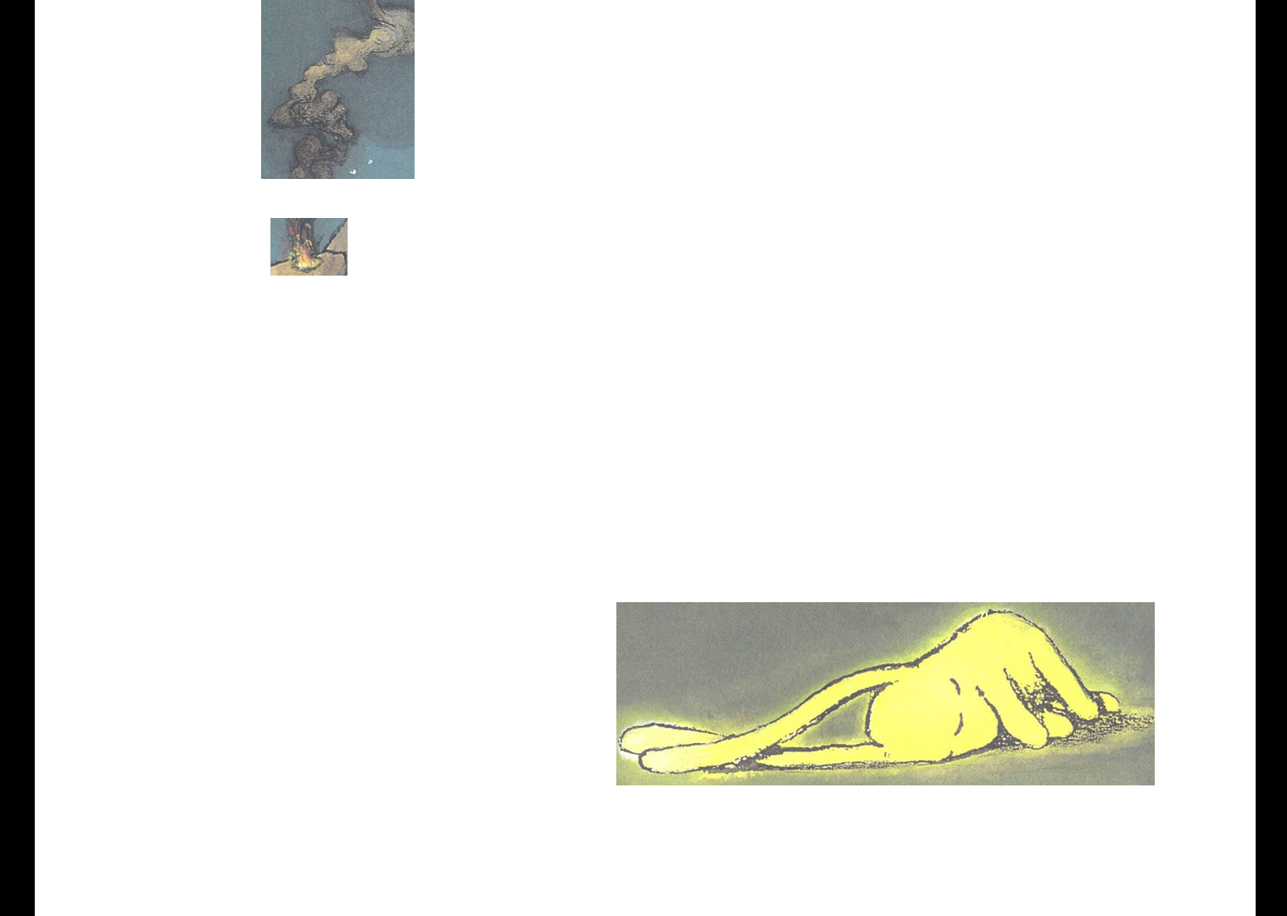
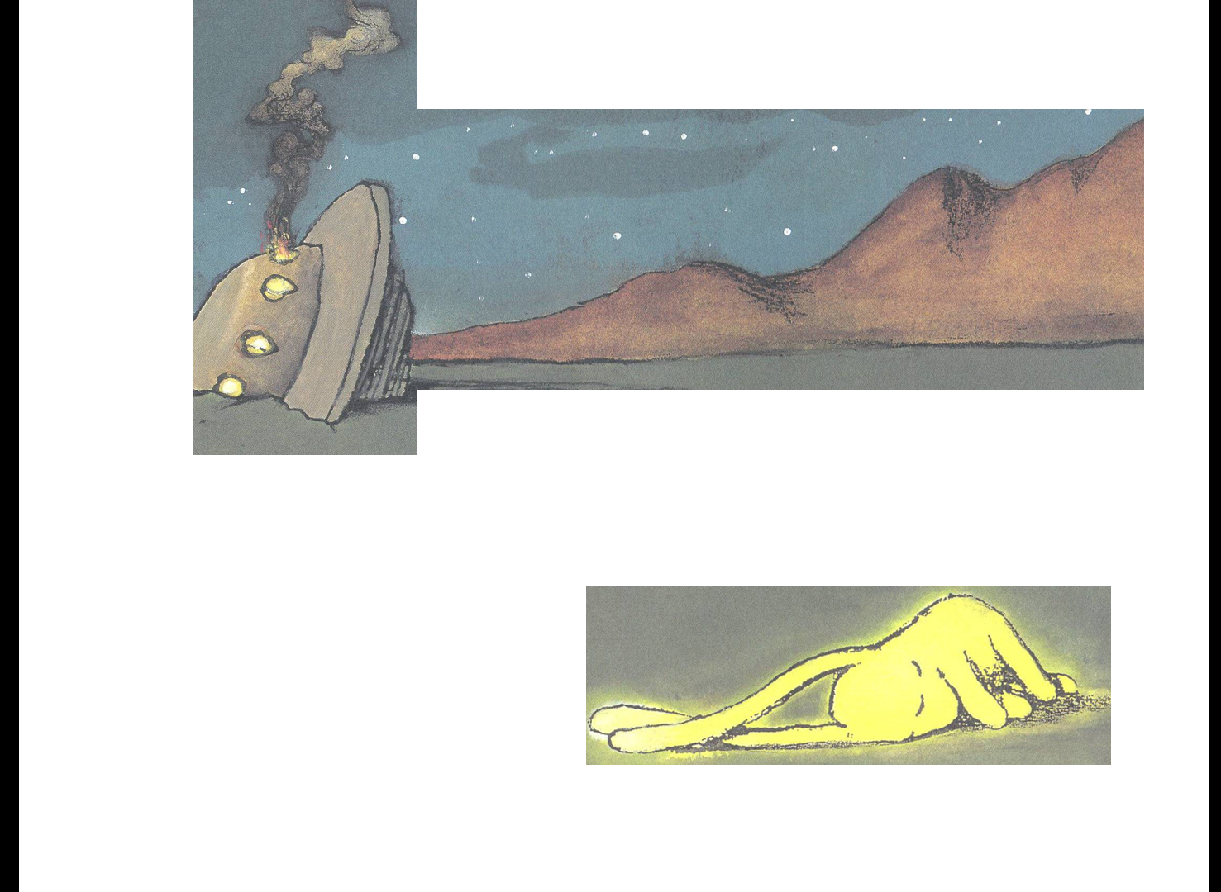
ENGAGE WITH THE CHARACTERS
Suitcase, backpack, bag ,box, contents of his/her pocket:
Pack together a group of items relating to the character and story as clues. The children explore them together and try to deduce what they think the items tell them e.g. why the character might need them, the character’s interests and passions etc.
Picture of the character’s bedroom
As above. What does the wallpaper/wall colour, bedspread, toys, ornaments, pictures or posters, objects etc tell you about the character?
Find a dragon’s nest/ eggs (or adapt for a different creature e.g. large box they are being transported in with labels, claw marks etc):
There is a note from an explorer or scientist explaining what it is. The note could be torn or burnt just before the description of what sort of a creature is inside the egg. This acts as a stimulus for the children to describe what could be inside e.g. invent and describe their own dragon.
These can be made using polystyrene, with drawing pins for a metallic effect, or papier mâché (this allows the eggs to gradually hatch and reveal parts of the dragon each day).
Record/play an interview with/interview staff/people who have witnessed something or use eye-witness accounts to describe what may have happened.
Edited pictures:
For example, edit pictures around school or the local area showing a villain from your narrative such as the big bad wolf, who you need to catch and stop, or a character in trouble e.g. Beegu, who you need to find and help. This could lead into character descriptions, wanted posters etc.
SETTING FOCUS:
Discover a doorway or a peephole:
Create a doorway to a mysterious land or a setting from a story e.g. ‘Journey’ by Aaron Becker, The shop in the ‘Nowhere Emporium’ by Ross McKenzie. This could be an old door, a curtain, a clothes rail to step through, a mock up of a door on the classroom wall etc. Children have to predict and describe where the door will lead to, using the clues as well as any text information they have.
Provide clues and some sights, sounds and smells by providing a ‘peephole i.e. something to look through such as a keyhole, gap in a wall or door etc. This should provide ‘glimpses’ of the setting, clues to what is there, rather than the children having to predict from imagination only. It serves to guide their thinking and gives them some initial ideas to build a description form e.g. set up a secret garden with a gap in the wall and place some clues such as plants, pot plants, keep out sign, extra large gloves and boots etc. for the ‘Selfish Giant’
Slow reveal a picture:
Use the white board and slowly reveal different parts of a picture – each reveal adds more to the children’s understanding of the place and situation.

Slide 8
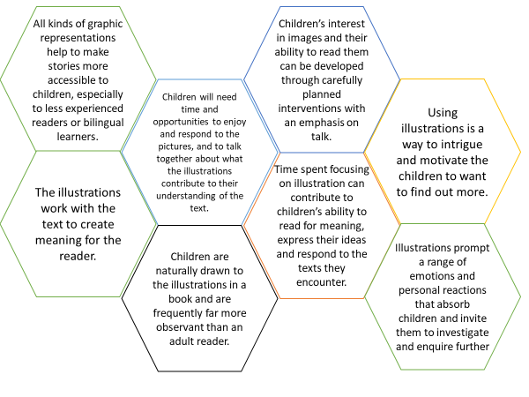
2. Immerse Children in Content
During this phase of teaching, the aim is for children to gain content for their writing i.e. what to write about. This will involve in-depth discussion and exploration of the core text of the unit. Teachers plan tasks, activities and approaches in this phase depending on the written outcome of the unit e.g. if the written outcome is a character description, tasks in the immersion phase will focus on getting to know the character really well; if the written outcome is a discussion, the immersion phase will focus on understanding differing viewpoints of a situation; and if the written outcome is a non-chronological report, the immersion phase will focus on understanding and learning facts, ideas and information that can be used in a report etc.
Key approaches used in this phase will include
Reading and re-reading the text (see next page for further detail)
Book-talk (CLPE say ‘Children need frequent, regular and sustained opportunities to talk together about books that they are reading as a whole class. The more experience they have of talking together like this the better they get at making explicit the meaning that a text holds for them.’). Discussing characters, situations, actions, vocabulary used etc
Exploring ideas and characters through drama: hot-seating character, real or imagined, freeze-framing scenes, the role of an important object in a story, the conscience alley of a troubled person, thought-tapping of central character or communal voice to share an important conversation.
Group discussion through activity/a shared task e.g. ranking attitudes that helped a character to succeed, constructing a role on the wall, decision line or emotions graph.
Questioning (by the teacher and by the children)
Exploring text structure and the sequence of events
Analysis of ‘stand out’ words, phrases and sentences
Use of film clips
Focus on illustrations:

Slide 9
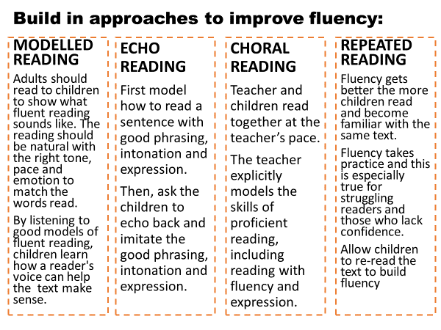
Reading and Re-reading
We expect teachers to use every ‘read-aloud’ as an opportunity to model fluent and expressive reading to the children. When reading to the children, we are teaching fluency: how you change your voice, pace, intonation etc.
As appropriate, teachers will build in regular opportunities for echo and choral reading so that children can practise these skills for themselves.
Throughout the immersion stage, children will be given opportunities to read and re-read the text (in short sections) for themselves to build understanding and confidence in the content for their own writing.
Research, Reading and References Used to Support the Approaches:
Tim Rasinski (The Mega Book of Fluency), Matt Tobin (Senior Lecturer in Education, Oxford Brookes University), Centre for Literacy in Primary Education (CLPE), Aidan Chambers (Booktalk), Pie Corbett (Book talk)

Slide 10
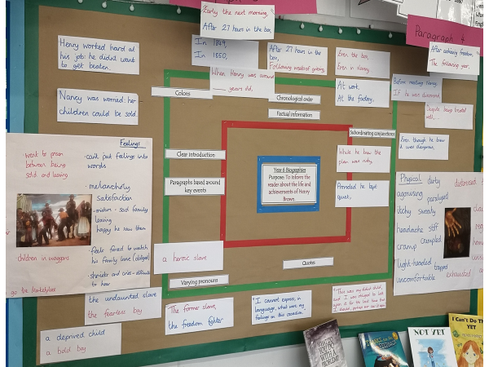
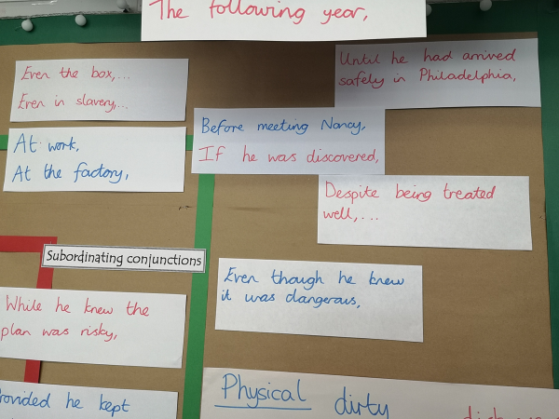
3. Writing Tools and Techniques
Crafting Sentences:
We know that writing is a complex process, so it is important that we break this process into smaller and more manageable ‘chunks’. Asking children to write full sections or paragraphs using the grammar and writing techniques we have just introduced and taught will overwhelm the majority of children (consider the implications for cognitive load). Instead, we teach children to write effectively by honing in on sentences and allowing children to practise skills, develop style and learn to ‘craft’ good sentences in a manageable way. This is then applied in ‘short burst’ writing and later into longer, more sustained writing.
In practice, this will be planned in lessons in a variety of ways:
Examining mentor and model texts – considering how specific techniques have been used in high quality texts. Make it explicit that this grammar/technique ‘can be used to___’ and ‘improves your writing by ___’
Teacher modelling – how to use the skill/technique in a sentence (in the context of the current unit). How and why does it enhance the writing – a clear focus on audience and purpose as the teacher models the choices s/he makes and why/how the technique is used.
Skills practice – children focus on including specific grammar at sentence level. Plenty of opportunity is given to practice sentences and FEEDBACK is key at this stage i.e. when the technique has/hasn’t been effectively applied and why, pick up on misconceptions and feedforward into further teaching input. Proof reading and editing are built into grammar practise tasks. Ensure children understand and have a good grasp when they are concentrating at a sentence level before they are expected to apply it into longer/connected text
Record the skill or technique by adding it to the class toolkit with examples of effective sentences so that the children have a clear point of reference when writing.

Slide 11


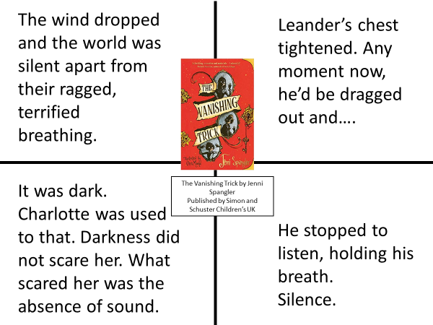
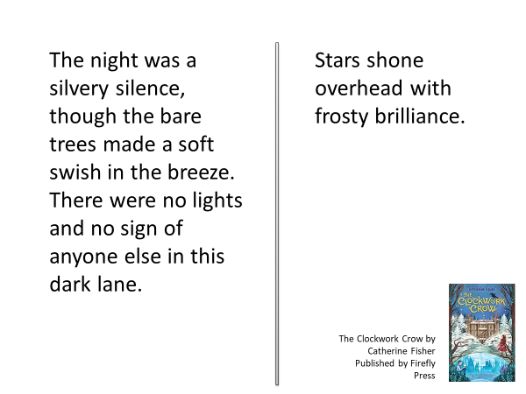
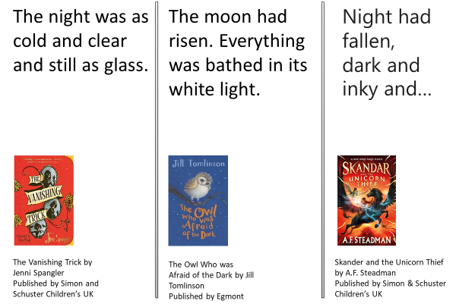
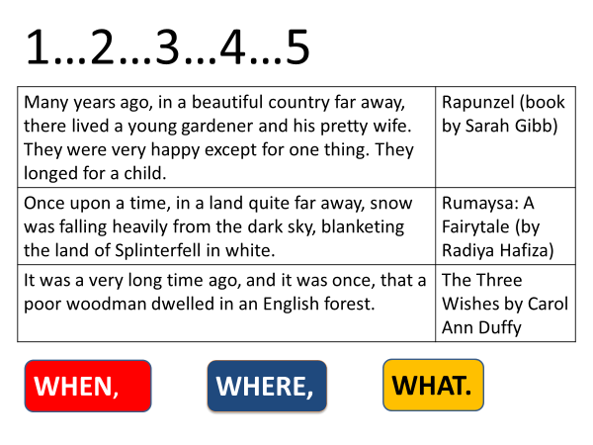
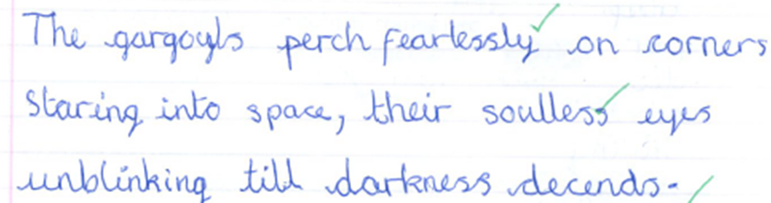
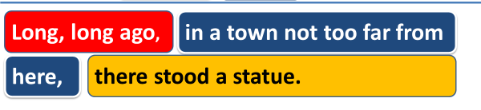
Pedagogy:
How do our teachers develop children’s understanding of grammar rules and writing techniques?
Model Texts:
Children need to study model texts that match the genre/writing form that they are being asked to write. We ensure that children are given plenty of opportunity to read genuine high-quality examples of the type of text they are going to be writing themselves (this means more that one example text to analyse: it means exposure to many examples ranging from complete texts to short sections that illustrate particular techniques, sentence structures and language use.)
We aim to support children to
Read as a Reader: appreciate and enjoy the text and the effect it has on them
Read as a writer: analyse, identify and develop an understanding of the tools and techniques a writer uses to create a certain effect
Think like a writer: Drawing children’s attention to the way a writer deliberately crafts sentences and builds ideas, bridges the gap between reader and writer and supports children to develop a ‘writer’s eye’(i.e. to become more careful and considered in the choices they make and have an understanding of the effect those choices will have on the audience).
Model texts may be used in the following ways across school:
Analyse and become familiar with features of the genre and form (organisation and layout)
Compare model texts – ‘what an effective/less effective one looks like’
Examples of model texts are available in the Gateshead Toolkits ‘Raid Your Reading’ section and, if appropriate, these should be supplemented with models chosen by the class teacher to fit the learning objective.
Read and analyse. Identify the way the author has used different techniques e.g. techniques that create tension: | Read multiple texts that use the same technique to understand its effect and how to use it in different contexts or to consider how author’s choose words and build images e.g. describing darkness:
Overwriting (using the structure of the original text and changing words to explore different effects) e.g. Original Text: Night of the Gargoyles by Eve Bunting: The gargoyles squat high on corners staring into space, their empty eyes unblinking until night comes. Overwriting by Y6: | Assimilate and integrate a sentence technique into the context of their own writing e.g. Story openings using double fronted adverbials: Year 4 child experiments with different options:

Slide 12
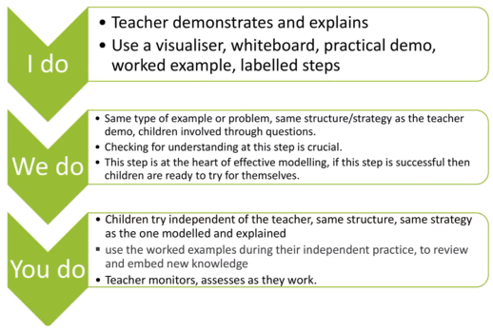
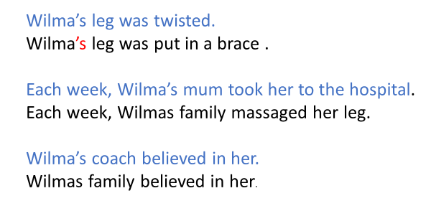
Retrieval Practice:
Previously taught grammar and writing techniques are regularly revisited and developed in line with National Curriculum expectations e.g. subordination is introduced in Year 2 and added to in each of the following years, we introduce similes in Year 3 and continue to develop children’s understanding and ability to create these through to Year 6.
When revisiting a writing tool, the teaching begins with retrieval practice:
What do the children already know about___?
When is it used? Why?
Give an effective/less effective example
As well as strengthening the memory for the children, this approach allows teachers to assess the starting point from which to take the teaching forward.
Scaffolding Writing Success: ‘I Do… We Do… You Do…’
When introducing new grammar or a new writing technique, the learning is scaffolded to ensure children are guided to understand how, why and when to apply effectively.
Assessment and feedback at step 2 (‘We do’) is vital to ensure that children can successfully apply the technique into their own writing.
Pedagogy:
How do our teachers develop children’s understanding of grammar rules and writing techniques?
Worked Examples:
Worked examples manage the cognitive load placed on working memory, and allow children to focus their attention on the key feature e.g. a punctuation rule. Freeing up space in the children’s working memories to focus on the punctuation rule means they are more likely to remember the rule and apply it correctly.
Teachers should construct worked examples with care and ensure that, in the beginning stages of learning a rule, the sentences that the children punctuate for themselves are closely matched to those in the worked example e.g.
As confidence and understanding grow, the worked example is gradually withdrawn. The rate of the withdrawal may be different for different groups, depending on need.
Dictation:
We use dictation as an approach to practising punctuation and spelling rules. Short, regular dictation sessions are built in each week. The sentence length, type and complexity should be matched to the age group expectations.
Rationale:
we know that the complexity of writing can place a heavy load on working memory, especially for novices. Dictation is one approach that we to reduce that cognitive load
through explicit teaching and deliberate practice, children can develop and extend their ability to write proficiently
the short focused nature of dictation allows teachers to provide specific feedback
Research, Reading and References Used to Support the Approaches:
The Writing for Pleasure Centre (The Science of Writing), Rosenshine’s Principles of Instruction, Education Endowment Foundation (EEF Improving Writing), Pie Corbett (Talk for Writing)

Slide 13
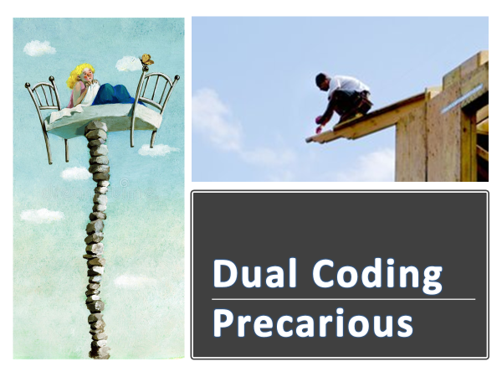

Exploring Vocabulary
There are different ‘layers’ that we move through within our vocabulary lessons:
allow children to think of their own words (this is the first layer and will be the first words that come to mind) e.g. nosey
discuss word choices with other children, expand and add some further suggestions to their original ideas and think more carefully about word choice e.g. spying, snooping
the teacher adds in some more complex/tier 2 vocabulary to learn and use (this 3rd layer should be about targeting and teaching new vocabulary). E.g. curious, inquisitive, glum. In each unit of work, we identify words (usually around 4-6) that will be explicitly introduced and taught to the children. These words are outlined in the medium term plans
Within our writing curriculum, we target and explore words and phrases with the aim of broadening children’s vocabulary and deepening their understanding of the nuances of words. Our aim is to support children to develop a rich and varied vocabulary that they can apply to good effect in their own writing. Teachers are expected to identify important vocabulary before the unit begins and to specifically teach this to the children, and displaying this vocabulary in the classroom.
Explicit teaching of new vocabulary follows a ‘script’:
This word is glum
Say it with me “glum”
What is the word? (glum)
Glum describes someone who is sad and quiet because they are unhappy about something
What does glum mean? (sad and quiet because you are unhappy about something)
What is another word for sad and quiet? (glum)-Flip flop
Tell your partner about a time when you felt glum.
Use it in a sentence stem “I was glum when…
‘Dual-coding’ is an important approach to use when teaching new vocabulary as the dual coding of sounds (the word) and image is much more likely to result in the child remembering what the word means than if the child reads or hears a definition alone.

Slide 14
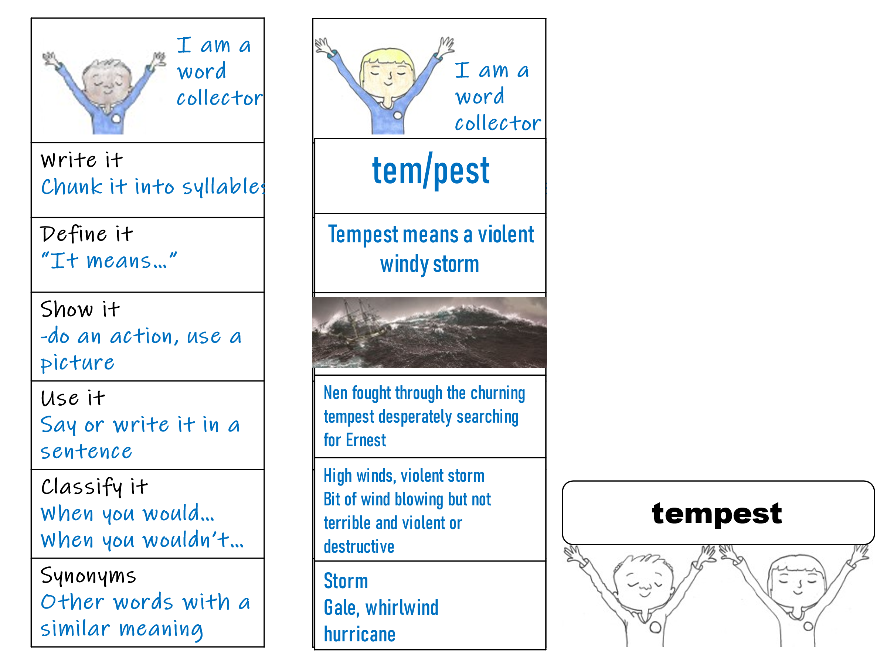
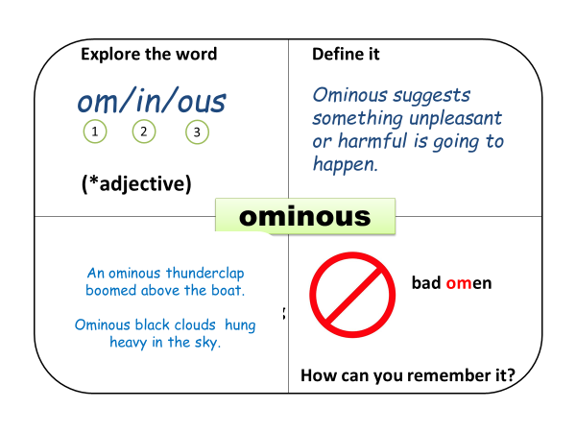
These ‘new’ words are explored in depth to support children to understand the ‘nuances’ of their meaning e.g.
We expect that time is taken to explore a word because we want children to have a deep, not a ‘surface’, understanding e.g.
Is destitute the same as being poor?
Can a person ever be destitute if they have money?
What is a good way to help someone who is destitute?
We also aim to broaden children’s vocabulary by focusing on author’s vocabulary choice as children read and discuss the core text and as they plan vocabulary to use in their own writing.
If we draw on research on memory, we find that children need between four and ten exposures to a new word before they will remember it. Some studies suggest as many as 17! With this in mind, teachers will deliberately plan to revisit vocabulary already learned. E.g. once new words have been taught, teachers should deliberately plan to use the word/’drop it’ into conversation and teaching sessions in a variety of different contexts e.g. In Year 1, the children have learned the word ‘stroll’ and looked at it’s different forms – stroll. strolled, strolling, strolls. The teacher deliberately uses the word at different points in the week:
Vocabulary instruction is not a quiet, individual activity but one where pupils grapple with new words, the meanings of these words in relation to their lives and when and how to use them.
Graves, M. F. (2016), The Vocabulary Book: Instruction and Learning
It’s lunchtime. Let’s take a stroll down to the dining room.
What did you do at the weekend?
I strolled along the beach with my husband.
I can see Mr Marks strolling across the yard.

Slide 15
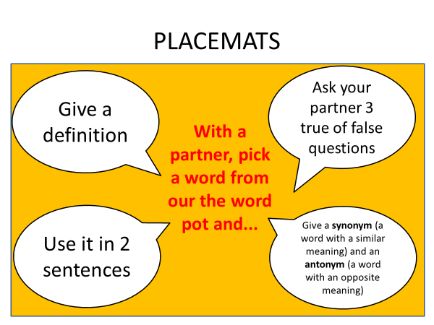
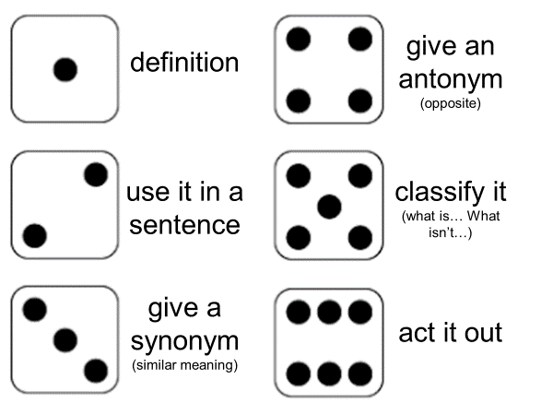
Children need multiple opportunities to hear and use a new word in the classroom rather than one-off teaching and will revisit words previously taught, through games and quizzes, at progressively longer intervals – at the end of the lesson, at the end of the day, later in the week, later in the half term, and at the end of term and year.
Each classroom has a ‘word pot’ in which the teacher stores lolly stick. Each stick has a taught word written on it and these are used regularly throughout the week to revisit previously taught words:
DICE GAME
Put a stick on each child’s table every day. As children enter class, they tell their partner, the teacher, the class the meaning of the word.
Pick a lolly stick and ask children to – define the word OR use the word in a sentence OR give an example of it.
Give a group a word and they have to come up with the definition – other groups have to guess the word. Make it into a challenge/competition – how many in 2 minutes etc.
The lolly stick pots move on to the next year group each September so that the new class teacher can also feed these words into his/her teaching and retrieval practice.
Regular retrieval practice:
Review the meaning with a question | Does agitated mean angry or worried?
Cloze procedure (with choice of a number of recently taught words) | Every time I walked past that house I felt more and more _____________. It gave me the creeps.
Example or non- example | The birds screeched. They could see Mrs Jones putting out the bird feeder. The birds screeched. They could see next door’s cat.
Replace the word | She seemed agitated and Mrs Turnbull wanted to help. She seemed _______and Mrs Turnbull wanted to help.
Word association | Milly knows she must hand in her homework but she has left it at home.
Finish the sentence | The dog became more agitated when…
Research, Reading and References Used to Support the Approaches:
Isabel Beck (Bringing Words to Life), Alex Quigley (Closing the Vocabulary Gap), Oxford University Press (Closing the Word Gap), M.F. Graves (The Vocabulary Book: Instruction and Learning)

Slide 16
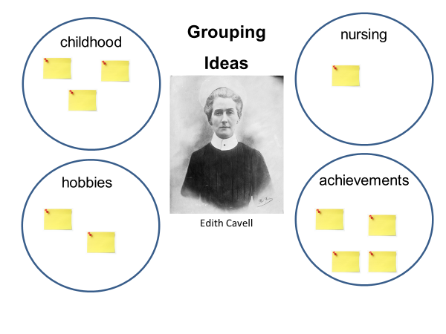
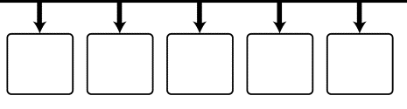
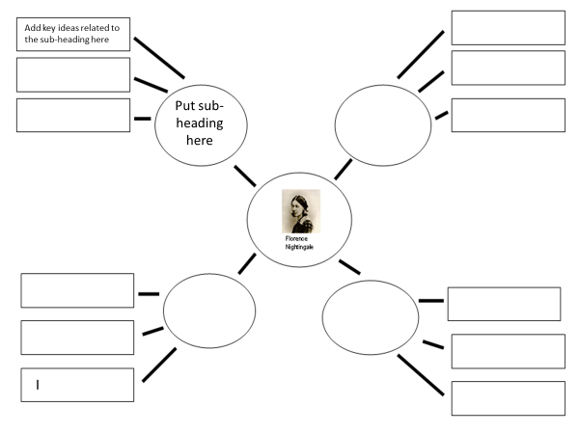
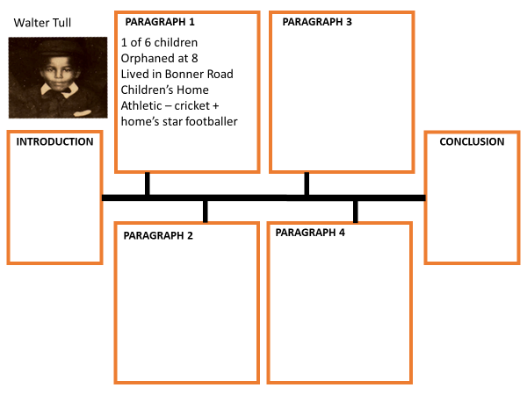
4. Planning
Giving children time to plan their writing allows them the opportunity to think carefully about what effect they want to have on their reader and the techniques, tools and content they want to include to achieve this effect. Planning should allow children to draw on the learning from the writing unit and think about how they want to use and include this in their final piece.
Key Points to Note:
Planning for the content, organisation, cohesive links, appropriate grammar and vocabulary and the layout of their final piece of writing will vary depending on the type of writing.
We expect our teachers to refer to the guidance give in the Gateshead Toolkits to ensure that planning formats match to genre/writing type e.g. timelines for non-chronological reports, story maps (KS1), 5 part story mountains (KS2) etc. for example the Biography Toolkit guides staff to appropriate planning formats for different year groups:
Teachers need to model how to draw previous learning into plans
Children need feedback in the planning stage (as in all other stages) to support them to be as successful as possible
Teachers need to model how to use plans to write connected text – particularly how to expand on ideas and ensure cohesion
Use a large timeline in class (for all age groups - to physically place event in sequence – this will help children to secure the chronology for their biographies

Slide 17
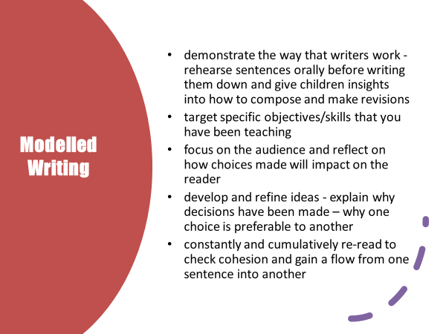
Writing (short burst and more sustained pieces)
The early stages of our writing units should equip our writers with the ideas/content, vocabulary and grammar knowledge needed for their writing. However, to support children to be successful writers, we ensure that they are taught how to bring the different elements together in connected text. Direct instruction, modelling and demonstrating how to craft writing is central to the unit of work.
This applies to ‘short burst writing’ as well as more sustained and developed pieces. Regular modelled and shared writing provides the children with explicit instruction and demonstration of how to compose before they write independently.
Teacher Modelling (I do):
To be truly effective, we know that modelling needs to happen at every stage of the teaching sequence (not just at the drafting stage). We expect to see teachers modelling at word level (vocabulary generation and choice), sentence level (honing sentences – grammar, punctuation and composition/effect) and text level (short writing tasks, planning, cohesive links, main written piece).
Teachers use the white boards and flip charts to show the children how to do something in writing. The teacher will commentate as s/he writes to explain thinking and reveal why certain decisions are made. Errors will be included deliberately and act as learning points to discuss and tackle common errors/specific objectives. Modelled writing sessions should be focused and fairly brisk to hold attention.

Slide 18
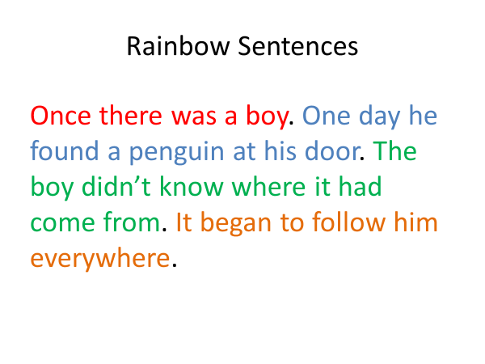
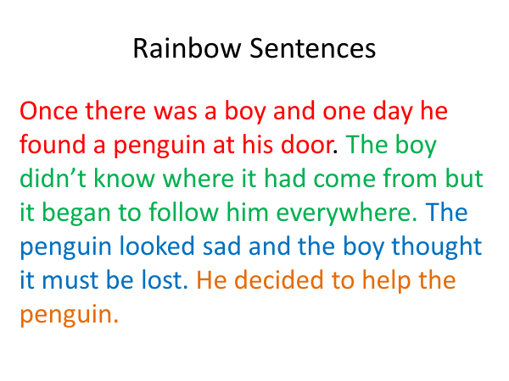

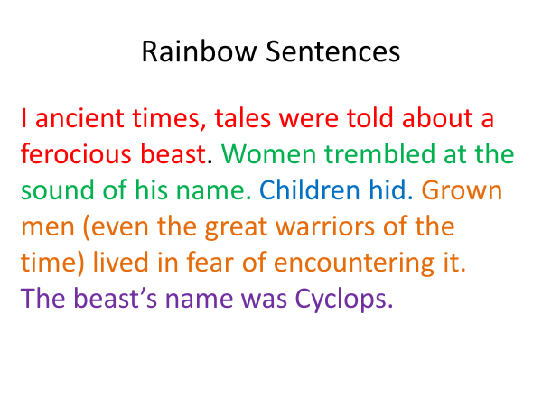
Rainbow Writing
When our teachers are modelling writing on the board, they all use ‘rainbow writing’ (R-Y6). This means that they use one colour for a sentence then change colour for the next sentence and so on. This offers our writers a visual clue about sentences and their demarcation and supplements direct teaching on punctuation. In KS1, the aim is to embed basic sentence punctuation on a daily basis. In KS2, the aim is to secure understanding, particularly as more complex structures are introduced.
Shared Composition (We Do):
The teacher and the children contribute to a shared write. The teacher’s role is to prompt, guide and challenge children to think about writing ideas, the choices they make and the effect on the reader. The teacher continues to act as scribe and this is important as it allows the children to focus on composition and crafting their ideas.
This element of writing instruction allows our teachers to assess children’s understanding and readiness to work/write independently.
Independent Writing (You Do):
Children apply what they have learned into their own writing.
As children write, the teacher’s role is two-fold
Circulate to assess children’s writing and decide, if and when, to use a ‘learning stop’ to address any issues seen. This may be a whole class leaning stop or targeted at a small group.
Some children, particularly weaker and less confident writers, may need the writing to be broken into smaller chunks with teacher input between each ‘chunk’ of writing. The teacher plans to support these children as appropriate

Slide 19
5. Proof Read, Edit Content and Improve
Meaningful feedback supports pupil progress, building learning, addressing misunderstandings, and thereby closing the gap between where a pupil is and where the teacher wants them to be. This process is a crucial component of high-quality teaching.
Becky Francis (June 2021) Teacher Feedback to Improve Pupil Learning
In line with our ‘spiral’ approach to teaching writing, feedback, editing and improving writing happens at each stage of the process and NOT just with the outcome/end product piece. E.g. teachers feedback on the quality of vocabulary choices in short burst writing tasks, children proof read practise tasks in grammar to check the correct application of punctuation etc. Lesson time is routinely set aside for the teacher to model and for the children to carry out this important element of the writing process.
In our school, we ensure that children are taught and guided to both proof read for errors and edit writing to improve the quality and effect of the content:
PROOF READING | EDITING
Proof-reading involves pupils checking their work for punctuation and spelling errors only (e.g. they should note whether they have used specified punctuation correctly). The spelling rules they check while proofreading should focus on age appropriate words and the patterns they are studying as a year group. | Editing requires teacher, pupils and their peers to propose changes to their ideas, vocabulary and grammar in order to make their writing more interesting to read (e.g. I was scared could be exchanged for I felt apprehensive – anxious that no one would find us) The best way to teach editing is to model the process to pupils.
Proof Reading:
Our teachers explicitly model how to proof read and check for errors. Our aim is that non-negotiables, such as capital letters, letter formation and previously taught/common spellings are dealt with by the writer not the teacher.
Less secure writers find it more difficult to edit their own work, so more scaffolding is provided.
Where it is clear that a child has not understood something e.g. a specific spelling pattern or how to use a form of punctuation, this should feedforward into teaching (in the next lesson or ASAP)
Approaches we use to teach/guide children to proof read:
Proofread for only one kind of error at a time. If you try to identify and revise too many things at once, you risk losing focus, and your proofreading will be less effective. It’s easier to catch grammar errors if you aren’t checking punctuation and spelling at the same time and vice versa. In addition, some of the techniques that work well for spotting one kind of mistake won’t catch others.
Read slow, and read every word. Try reading out loud, which forces you to say each word and also lets you hear how the words sound together. When you read silently or too quickly, you may skip over errors or make unconscious corrections.

Slide 20

Separate the text into individual sentences. This is another technique to help you to read every sentence carefully. Try using an opaque object like a ruler or a piece of paper to isolate the line you’re working on.
Read the paper backwards. This technique is helpful for checking spelling. Start with the last word on the last page and work your way back to the beginning, reading each word separately. Because content, punctuation, and grammar won’t make any sense, your focus will be entirely on the spelling of each word.
Editing:
Editing sessions focus on improving the quality and effect of children’s writing. For editing to be successful, the teacher needs to read and formatively assess the children’s writing and identify a teaching point or key area/technique to ‘feedforward’ into an editing lesson.
Formative assessment takes place
in lessons - ‘catching the children’ at the right time to move the learning on and then using a learning stop to address a teaching point and/or
after lessons - by reading and assessing across the class collection to identify aspects of the learning that need to be addresses/learning to be revisited and reinforced.
Editing lessons
focus on specific features and writing techniques
teach children how to edit through teacher modelling and guiding children through the process
Author’s Chair
We aim to develop children as reflective writers by giving ample opportunity throughout the writing process to talk about themselves as writers, enable them to voice their views, listen to others and develop new knowledge and understanding. One approach we use across school is the ‘author’s chair’
How it works:
One child reads their work to the class/a group
Teacher initially models feedback.
Practise and build up children’s ability to feedback constructively

Slide 21
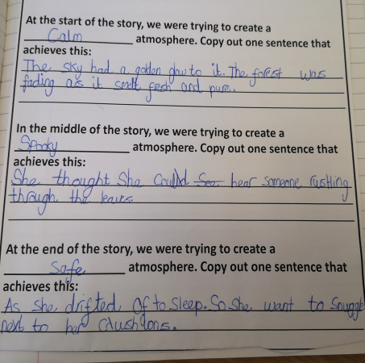
Peer Assessment
A central part of our writing curriculum is that we teach children to ‘think like a writer’ and develop a ‘writer’s eye’ (i.e. to become more careful and considered in the choices they make and have an understanding of the effect those choices will have on the audience).
Peer assessment plays an important role in supporting out children to think like writers. As children move through school, they become more able to share and comment on each other’s work, judge and evaluate and suggest improvements. Peer assessment is always carefully scaffolded.
KS1
Peer assessment looks at the ‘sense’ of a piece of writing:
children are asked to read their writing to a partner
The partner comments if anything doesn’t make sense to them or if a word or information is missing
Lower KS2
As above +
Give the children one key aspect to focus on e.g. “You are going to look at the similes your partner has used today and tell your partner what you think of the quality of their similes.”
Is the comparison clear and easy to understand?
Does the simile create a picture for the reader?
Does the simile fit with the time period and the place?
Upper KS2
As above +
Guide children to consider effect and impact of the writing in a more detailed way e.g.
Have you created and maintained the atmosphere all the way through your setting description?
Does your writing develop the argument by introducing a point and then adding more detail in the next sentences (ideas, facts, expert opinion)
Find and the section where you and your partner think you have done this this best
Is there a paragraph you need to improve and add some more supporting ideas?
Look with your partner and decide where to make an improvement
Have you made a strong argument and used adverbs and modal verbs (e.g. definitely, certainly, will, must etc) to convince your reader
Underline your 2 best examples in green.
Research, Reading and References Used to Support the Approaches:
Education Endowment Foundation (June 2021) Teacher Feedback to Improve Pupil Learning + A Marked Improvement, Focus Education, Dylan Wiliam, Douglas Fisher and Nancy Frey (2009) Feed Up, Back and Forward

Slide 22
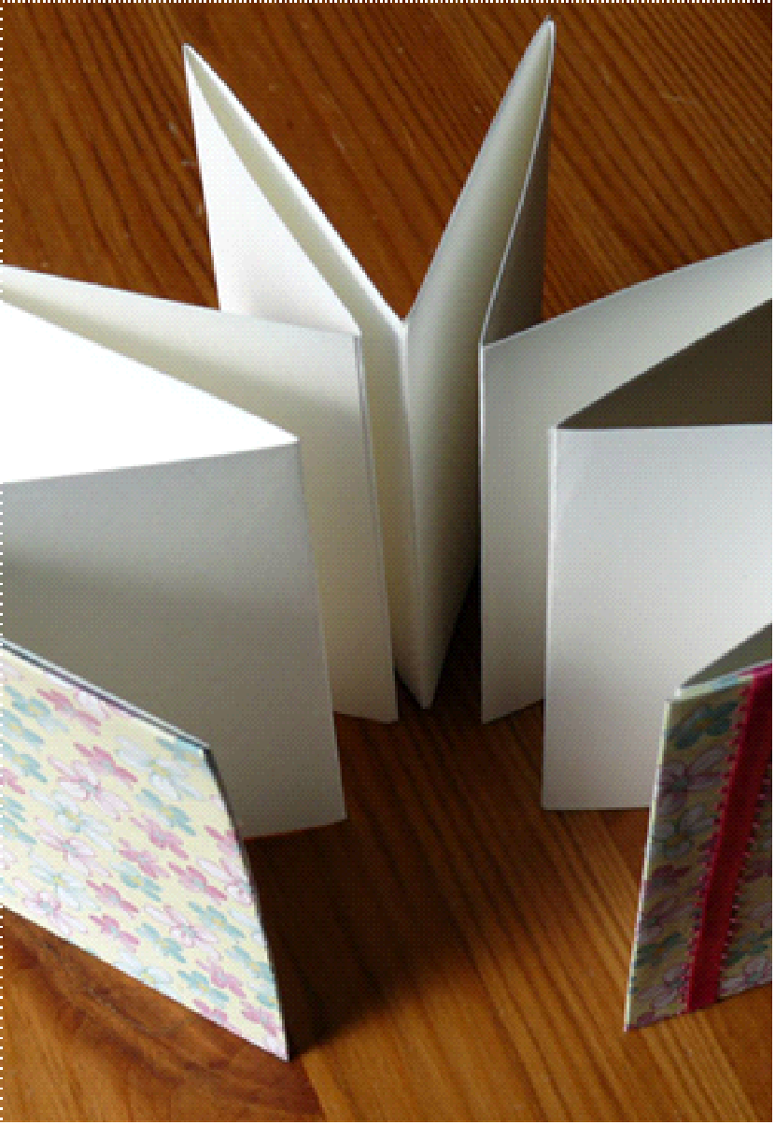
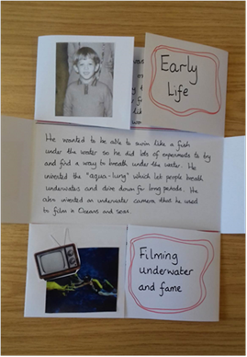
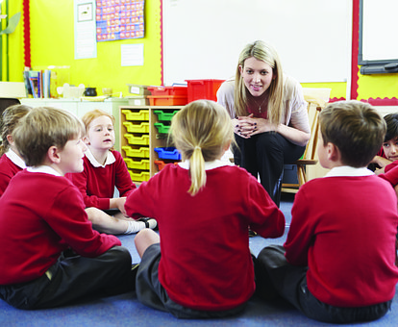
5. Publish the Writing
We strongly believe that when children are given real reasons to write, it impacts positively on their written outcomes. Taking a piece of writing through to publishing to an authentic audience gives clear purpose for the writing and a sense of achievement for our writers.
There are many different ways to ‘publish’ the children’s writing. What is key is that children know that their writing is meeting its intended purpose and is sent/presented/shared with the intended audience e.g.
Sending the letter, leaflets, reports etc directly to the intended audience (and ensuring that children ‘see’ that this is happening)
Posters produced are displayed to the intended audience (e.g. in the library/school/local community centre etc)
Set up an event e.g. class museum to present non-chronological reports to parent or other classes. Invite ‘guests’ and sent up displays and writing to be shared
Narrative and Poetry:
These are meant to be shared in some way e.g.
Publish verbally – read the story to a classmate, child in another class, take home a copy to read to a family member, poetry slams/performances, record
Publish in writing: display, include in a class anthology/book of short stories, individual book making (think about where to share these – in class, library, school display, parent session in school or take home)
Use Available Technology
Publish on See-Saw
Use Power-point to record presentations and share across classes
Use green screen to record and narrate stories or information/biography/report etc
Virtual tours
A unit of writing always finishes with the final piece appearing in the child’s own portfolio – which will follow them through school.

